Slide 1


SRM INSTITUTE OF SCIENCE AND TECHNOLOGY
VADAPALANI CAMPUS, CHENNAI - 600026
DEPARTMENT OF COMPUTER SCIENCE ENGINEERING
PROJECT TITLE :
IOT BASED SMART INDUSTRY MONITORING
AND ALERTING SYSTEM
by
TEAM MEMBERS
Ramya Ramakrishnan
IV CSE-C
RA1711003040001
K Saivarun
IV CSE-C
RA1711003040117
M Kishore
IV CSE-C
RA1711003040141
Project Guide : Dr. A. Kathirvel
Project Coordinators : Mr .D Manikkannan
Dr . P Mohamed Fathimal

Slide 2
ABSTRACT
In this demonstration proposal,
A Prototype of IoT Based Smart Industry Monitoring and Alerting System to monitor, locate and successively alert gas leaks of a complex factory environment.
Unlike Traditional Systems, we’ve used IoT technology to make a Smart Industry Monitoring and Alerting System and to perform data analytics on sensor readings using cloud service successively.
This will detect any leakage of harmful gases, supporting and displaying the level and the location of the leakage.
The aim of this project is to develop such a device that can automatically detect and alert the corresponding officials thus, stopping gas leakages in those permeable
Throughout the demonstration, the technological advantages of our prototype – “IoT Based Smart Industry Monitoring and Alerting System” are explored.

Slide 3
EXISTING SYSTEM IOT Based Industry Quality Monitoring System
Architecture Description
Sensor monitoring pollution level and Monitoring the gas leakage level which updates to the given server.
Monitors the gas leakage level using Raspberry Pi. The real time data obtained from the different sensors which sense’s the different concentration of gases.
Methodology
The development of pollution monitoring system with deployment of intelligent sensors is being carried out.
Monitoring the gas leakage level is achieved.
Analysis of the data is simplified thereby enabling ease of monitoring.
Alerts can be triggered in case of drastic deterioration of air quality using Raspberry Pi based gas detection system - detect the presence of toxic gases respectively

Slide 4
RESULT OF THE SYSTEM
Able to monitor and identify the changes.
This work demonstrates a gas leak detection system with real time location system based on WSNs.
This IOT based Smart Industry Monitoring system gives real-time monitoring.
Temperature, humidity, level of chemicals, also detects the Leakage of gas,
CHALLENGES TO BE ADDRESSED
Need a internet connections to access from anywhere in the world without cannot access | Wifi has limited range Speed of the most wireless network
Range affected by varies medium and slower than the cable.
Comparisons of particulate measurements are also problematic to measure
Range of reference-equivalent methods available and the limitations, in many ways, of the reference method itself.

Slide 5
PROPOSED PROJECT SUMMARY
A prototype of IoT Based Smart Industry Monitoring and Alerting System to monitor, locate and successively alert gas leaks of a complex factory thus, controlling the pollution.
The proposed model - has two server sections one is factory server and another one is TNPCB server. Sensors are used to monitor the pollution level and update to both factory and also TNPCB Server respectively.
This aims at analyzing the type of industry, studying the nature of processes involved and identifying the probability of gas leakage. In addition to gas leakage, fuel leakage can also be addressed.
Potential points can be identified and corresponding sensors can be installed which can monitor and record the data.
The obtained data is being sent to Cloud which facilitates monitoring by authorized personnel in TNPCB. Initiating preventive actions by alarms in case of any abnormalities found in the received data. Thus, by regulating their actions successively.

Slide 6
SOFTWARE AND HARDWARE SPECIFICATION
Software Requirements
Hardware Requirements
NODEMCU
Raspberry pi
LCD 16*2
MCP3008
GAS Sensor
Temperature Sensor
Humidity sensor
Relay
Buzzer
Power unit
Language Programmed: C++, Java
Compiler Used : Arduino Uno IDE
Other Softwares Used : Android Studio, VS Code

Slide 7
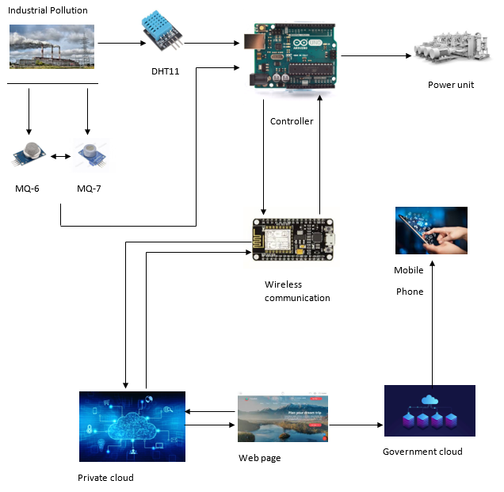
ARCHITECTURE DIAGRAM
SYSTEM DESIGN
Fig. 1 – Model Architecture Diagram

Slide 8
METHODOLOGY USED
Above the block diagram contains NODEMCU processor, Arduino UNO, gas sensor, temperature sensor, humidity sensor, power unit.
Sensors are connected to GPIO Pin of Arduino UNO. NODEMCU connected to UART Port of Arduino UNO, which collects the sensor values from Arduino UNO and sends them to the cloud.
The Sensor Values are updated to two server rooms (Factory Server and TNPCB Government Server) and are constantly stored in cloud database using Firebase.
If Processor receives abnormal values, a notification will be released in form of buzzer. TNPCB will send the warning message to respective factory official in their respective application developed for mobile
If the company does not abide pollution controlling process, the relay achieves the outage of power supply from the TNPCB’s action

Slide 9
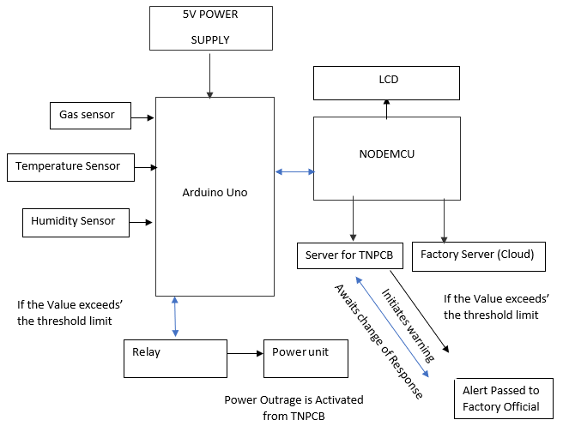
FLOW DIAGRAM
Fig. 2 – Process Flow Diagram

Slide 10
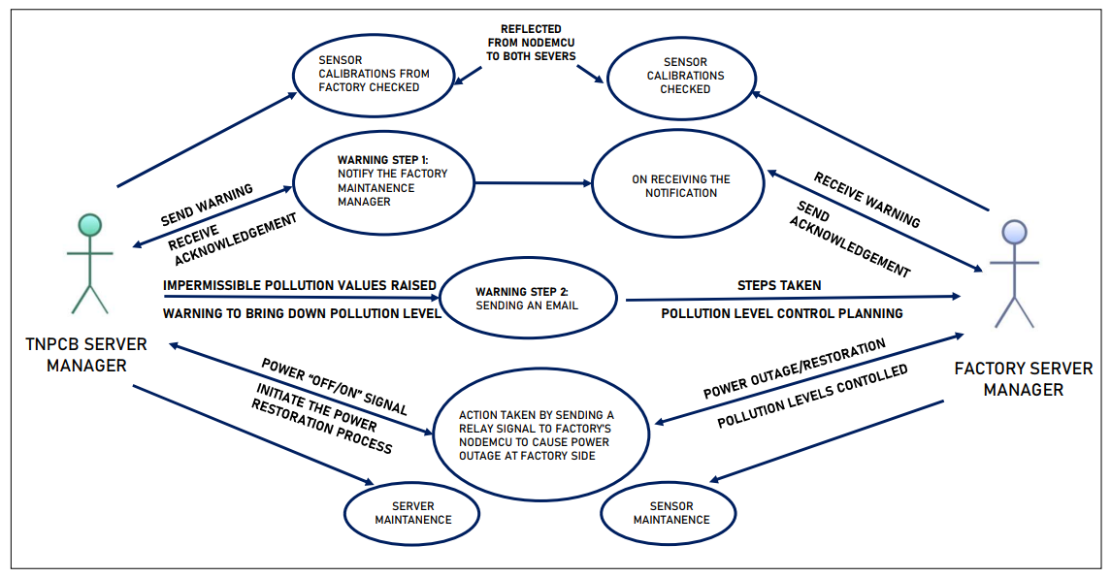
USE CASE DIAGRAM
Fig. 3 – UML Diagram

Slide 11
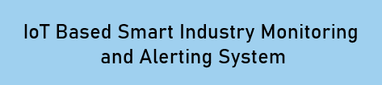
TECHNICAL MODULES INVOLVED IN THE PROJECT
Module – 1
Module – 2
Module – 3
Implementing Sensor
Integration
and Calibration
Integration of Data b/w Servers
(Private Cloud and Government)
with sensors
Real Time
Data Interpretation and
Live Action
of Power Outage Relay
Fig. 4 – Modules involved

Slide 12
MODULE – 1
Implementing Sensor Integration
and Calibration
Technical Description
In this system, NODEMCU acts as the internet connector and information accessing for the air quality and the sensor’s are calibrated successively and attached to GPIO Pin of Arduino UNO.
All Sensors are successively wired to PCB board and are connected directly component’s window as explained in the architecture illustration.
Then we integrate and calibrate the three sensors that detect gases and temperature and humidity respectively with Arduino UNO before the data detected is sent to the controller module.

Slide 13
MODULE – 2
Integration of Data b/w Servers
(Private Cloud and Government)
with sensors
Technical Description
In this system, we integrate the data between both the servers i.e. Public and Private Cloud through google firebase respectively with Arduino UNO before the data detected is sent to the controller module.
Both the Cloud’s are synced successively and are connected directly component’s window as explained in the architecture illustration.
The Sensor Values are updated to two server rooms (Factory Server and TNPCB Government Server) and are constantly stored in cloud database using Firebase.

Slide 14
MODULE – 3
Real Time Data Interpretation
and
Live Action of Power Outage Relay
Technical Description
Processor getting abnormal values from sensors it will activate buzzer sound reflected from both Government's and Organization's cloud server.
The two step process happening at this juncture are:
TNPCB would send one warning message to factory's authoritative pollution level manager.
In case the company doesn't make any pollution controlling process ,the power supply of the Factory unit is disrupted and the license will be canceled by TNPCB.

Slide 15
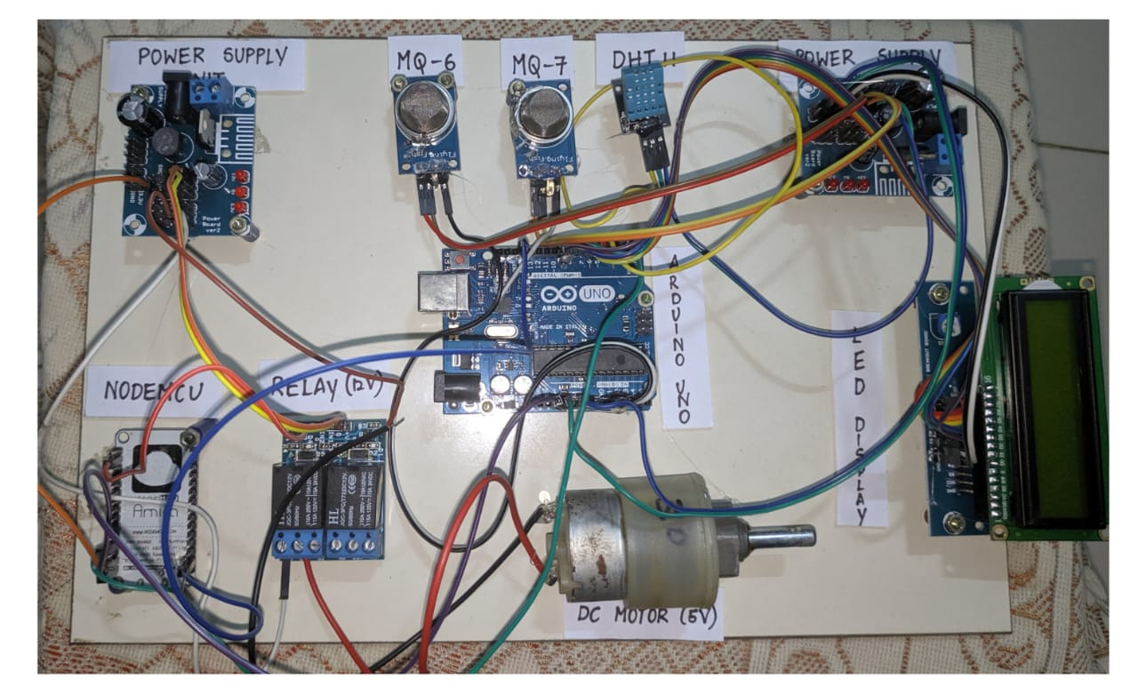
Sensors Integration & Arrangement
Fig. 5 – Sensors Integration & Arrangement

Slide 16
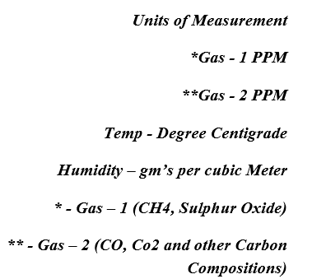
RESULTS AND DISCUSSIONS
The Prototype of Module – “IoT Based Smart Industry Monitoring and Alerting System” is successfully designed
Both the Clouds are synced successively and are connected directly in real-time which are used to monitor, locate and successively alert gas leaks of a complex factory thus, controlling the pollution.
The Sensor Values are updated to two server rooms (Factory Server and TNPCB Government Server) and are constantly stored in cloud database using Firebase.
Able to monitor and identify the changes in real-time.
Detects Temperature, humidity, level of leaked harmful gases from industrial premises successfully
Fig. 6 – Units of Measurement
&
Indexed values

Slide 17
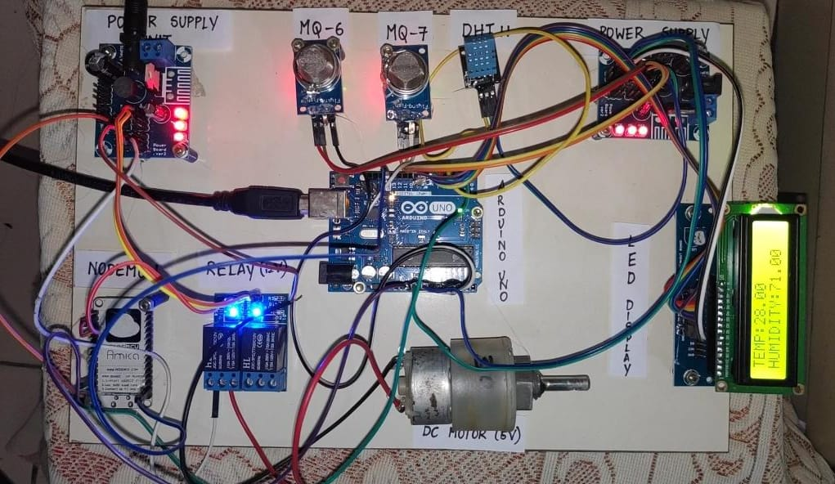
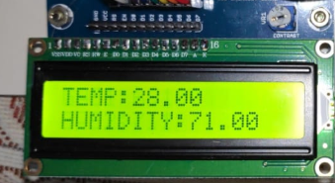
Screenshots of Final Module Demo
Fig. 8 – Module When Completely Powered ON
Fig. 7 – Real-time Readings Observed
*Firebase Details
Using Firebase in Spark Plan - 1Gb Free Data can be used

Slide 18
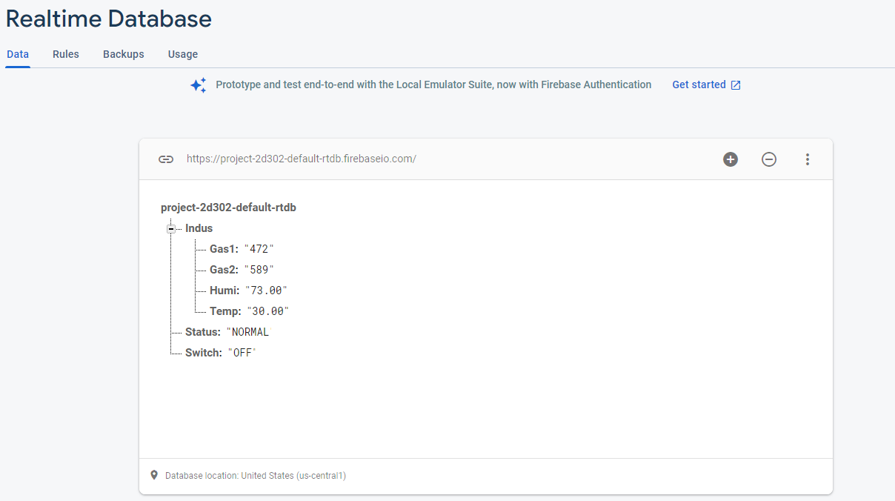
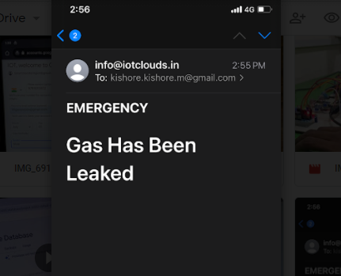
Screenshots Demo of Applications
Fig. 9 – Firebase Realtime Database
Fig. 10 –Webpage for the Government End

Slide 19
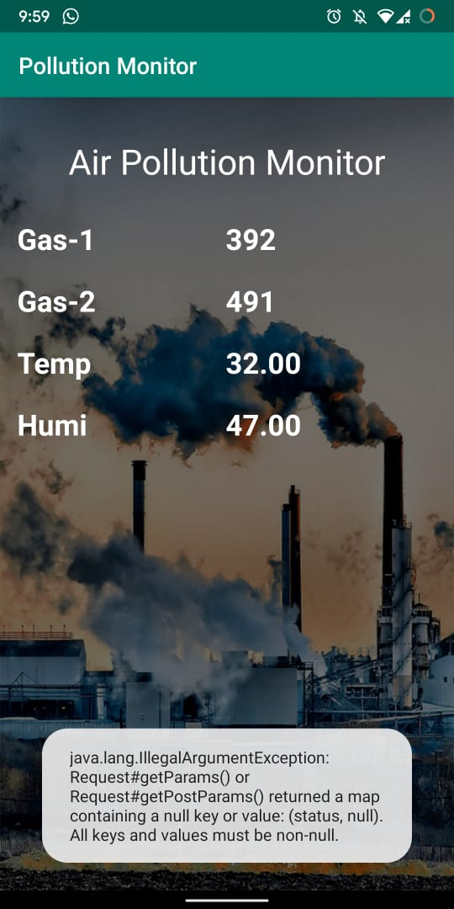

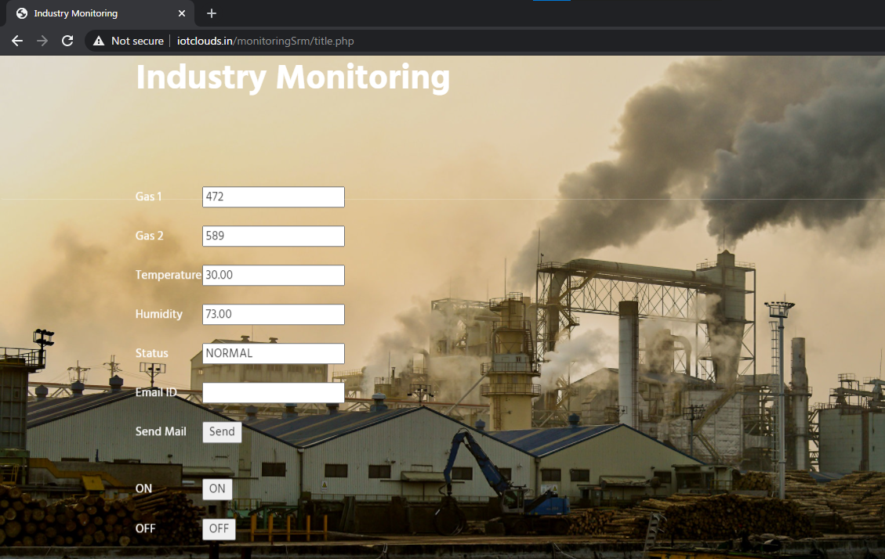
Screenshots Demo of Applications
Web Application
Mobile Application
Fig. 11 –Webpage for the Government End
Fig. 12– APK Working Screenshot & Readings Observed

Slide 20
CONCLUSION
This prototype of IOT Based Smart Industry Monitoring System is a wonderful step closer to a healthful livelihood.
With the assist of this tool now no longer handiest the industries can display the quantity of pollutants however even the authorities can take part withinside the system of controlling pollutants and make certain secure surroundings.
This automated version, as soon as set up is able to constantly monitor the pollutants stage and analyses the detected information.
The maximum highlighting function of this tool is that the output is represented in real-time and handy on clever telephones or even from the webpage.
The tool itself may be very green and does now no longer damage the surroundings in any way.
Moreover, it's far primarily based totally on one of the current technologies and additionally cheaper compared to different technology evolved thus far and may be set up efficiently.

Slide 21
FUTURE WORK
Predictive maintenance is an upcoming industrial need, for which the proposed model can be improvised. In case of gas leakage, the concentration of gas varies from point to point which can be analysed. These cases can open an eye for the budding researchers.
“ The best way to predict future is to create it.” ...
- Our Goal for a Sustainable Future
Analysis
Detect
Improve
UNDERSTANDING THE CURRENT
OPERATING LIMITATIONS
ADAPTABLE
AND FLEXIBLE
ON DEMAND
MODERNIZE THE CORE & IMPROVE FLEXIBILTY WITHOUT ANY DISRUPTION
Fig. 12 –Future Scope and Trends of Improving our model

Slide 22

PUBLICATION DETAILS
Journal Name : Springer: Lecture Notes in Electrical Engineering (https://www.springer.com/series/7818)
ISSN: 1876-1100.
Conference : International Research Conference on IOT, Cloud and Data Science
(IRCICD’ 21)
* IRCICD’ 21 – BOA Souvenir Attached – Page - 27

Slide 23
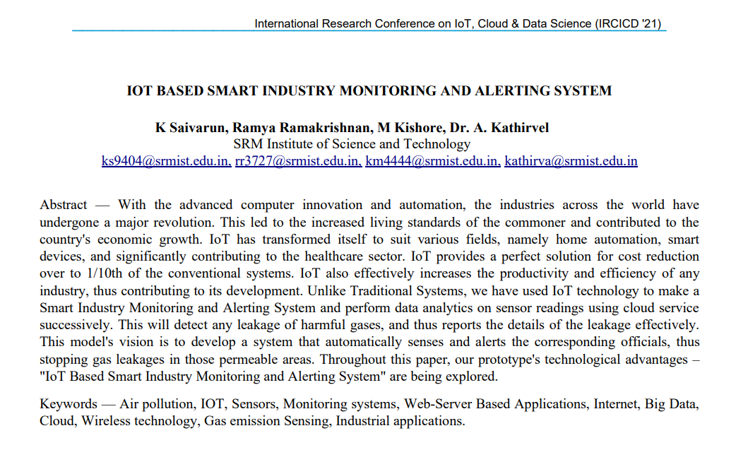
PUBLICATION DETAILS

Slide 24
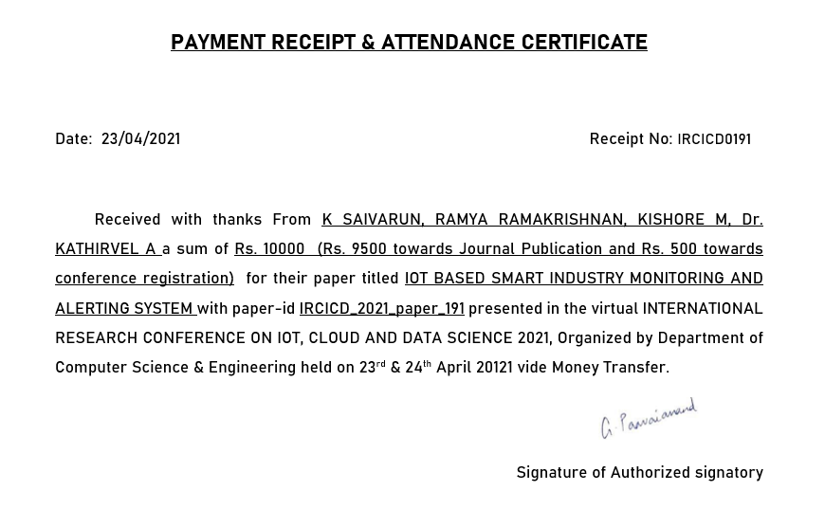

Slide 25
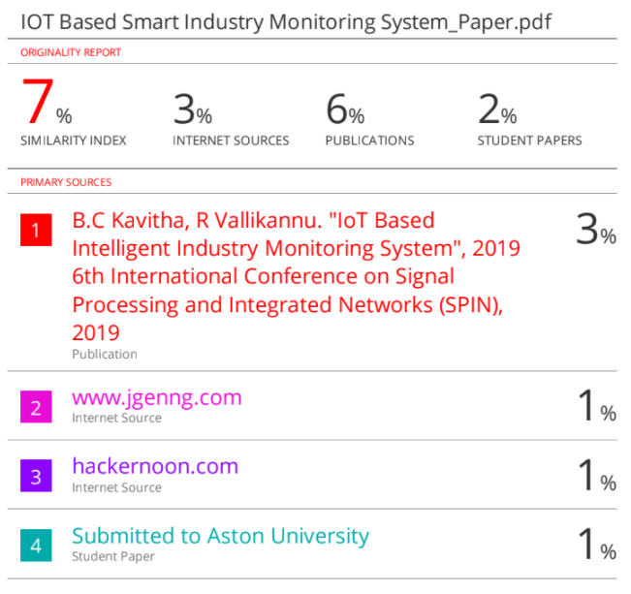

PLAGIARISM REPORT
Paper Published in IRCICD’21
Plagiarism % for Final Report

Slide 26
REFERENCES
[1] A Boubrima, W Bechkit, and H Rivano 2017 A new WSN deployment approach for air pollution monitoring, 2017 14th IEEE Annu. Consum. Commun. Netw. Conf. CCNC 2017, pp. 455– 460
[2] B Bathiya 2016 Air Pollution Monitoring Using Wireless Sensor Network 2016 IEEE International WIE Conference on Electrical and Computer Engineering (WIECON-ECE) 19- 21 December 2016
[3] A Škraba, A Koložvari, D Kofjač, R Stojanović, V Stanovov, and E Semenkin 2016 Streaming pulse data to the cloud with bluetooth le or NODEMCU ESP8266 2016 5th Mediterr. Conf. Embed. Comput. MECO 2016 - Incl. ECyPS 2016, BIOENG.MED 2016, MECO Student Chall. 2016, pp. 428–431, 2016
[4] K Keshamoni and S Hemanth 2017 Smart gas level monitoring, booking & gas leakage detector over iot Proc. - 7th IEEE Int. Adv. Comput. Conf. IACC 2017, pp. 330–332
[5] D Spirjakin, A M Baranov, and V Sleptsov 2015 Design of smart dust sensor node for combustible gas leakage monitoring Proc. 2015 Fed. Conf. Comput. Sci. Inf. Syst. FedCSIS 2015, vol. 5, pp. 1279–1283, 2015
[6] Anil H. Sonune, S.M.Hambarde,-" Monitoring and Controlling of Air Pollution Using Intelligent Control System",- International Journal of Scientific Engineering and Technology ISSN: 2277-1581,Volume No.4 Issue No5, pp: 310-313.
[7] Nikheel A. Chourasia, Surekha P. Washimkar," ZigBeeBased Wireless Air Pollution Monitoring" InternationalConference on Computing and Control Engineering(ICCCE 2012), 12 & 13 April, 2012
[8] Luay Friwan, Khaldon Lweesy , Aya Bani-Salma , Nour Mani. “A Wireless Home Safety Gas Leakage Detection System”, IEEE 2011.
[9] Ankit Sood, Babalu Sonkar, Atul Ranjan, Ameer Faisal, “Microcontroller Based LPG Gas Leakage DetectorUsinbg GSM Module, International Journal of Electrical and Electronics Research, Vol.3 , Issue.2 , pp: (264-269) ,Month: April- June 2015.
[10] D.Yaswanth, Dr Syed Umar,-" A Study on Pollution Monitoring system inWireless Sensor Networks",-D.Yaswanth et al | IJCSET |September 2013 | Vol 3, Issue 9, 324-328.

